Slide 1
SIP Course Project Presentation
Speech Emotion Recognition
Presented By :
Shubham Wasnik (17894)

Slide 2
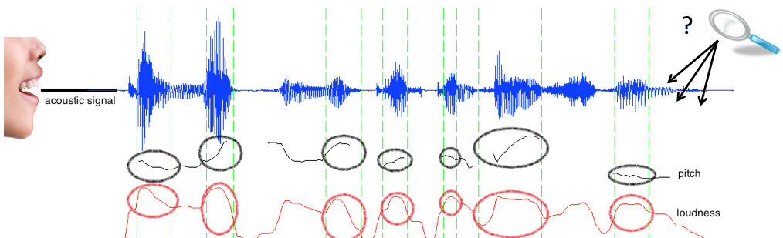
Problem Statement
The problem is to extract the features from the audio signal and and use these features for Classification of Emotion into 7 categories for both male and female.

Slide 3
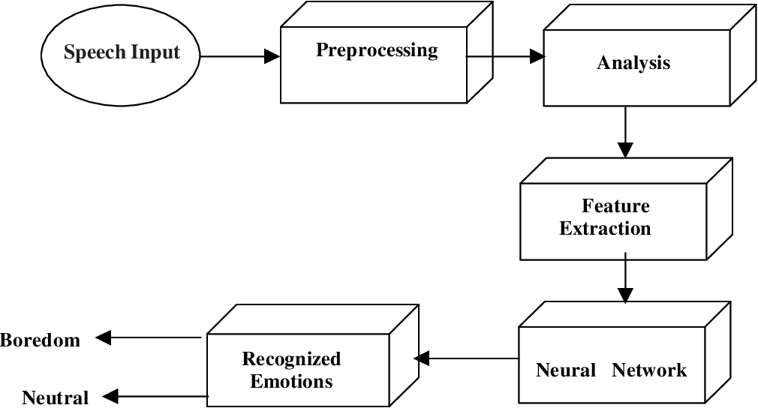
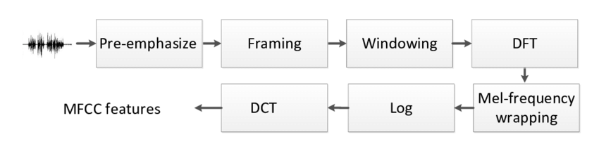
Theory behind the approach to the problem
Feature Extraction : MFCC

Slide 4
Experimental Setup
Complete description of the experiments
Dataset Used:
Ravdess Dataset
Tess Dataset
Libraries Used :
Librosa, Tensorflow, Scikit-Learn, Pandas

Slide 5
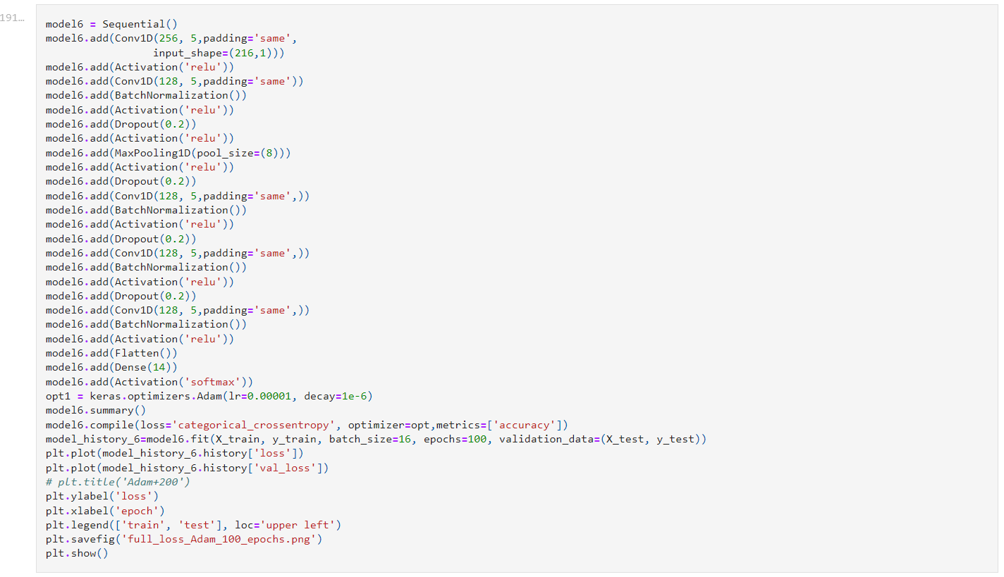
Details of the program
Data Pre-processing for 2 datasets
Finding MFCC features for each audio file and concatenating it in single dataframe
Splitting the dataset for Training and Testing
Training the Model
Evaluate the model

Slide 6
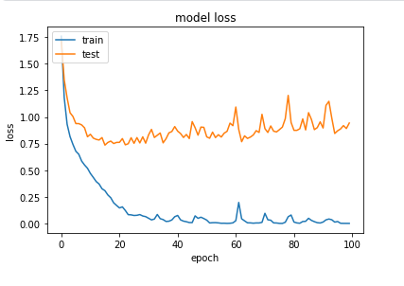
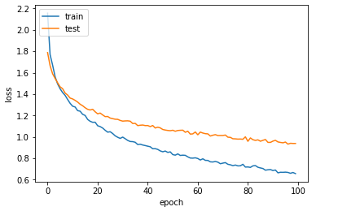
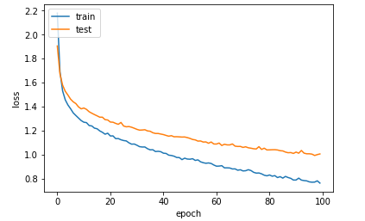
Results
Experiment 1
Experiment 2
Experiment 3

Slide 7
Conclusions
1) A lot of uncertainties are still present for the best algorithm to classify emotions. Different combinations of
emotional features give different emotion detection rate. The researchers are still debating for what features
influences the recognition of emotion in speech.
2) I calculated the MFCC features for each audio file in RAVDESS dataset and TESS dataset, concatenated the two datasets after calculating features for classification.
3) Building the model was challenging task as it involves lots of trial and error methods. The model is well trained to distinguish between male and female voices and it distinguishes with 99 % accuracy. The model was tuned to detect emotions with more than 70 % accuracy. Accuracy can be improved by including more audio files for training.
3) For model1.The model was overfitting and after experimenting with drop out and batch normalization and Epoch and optimizers, I got better accuracy on both training and test dataset. Some more Feature extraction techniques like MS feature and combination of these can also be used for better classification. Data augmentation techniques like adding noise, stretching can be used.

